Slide 1
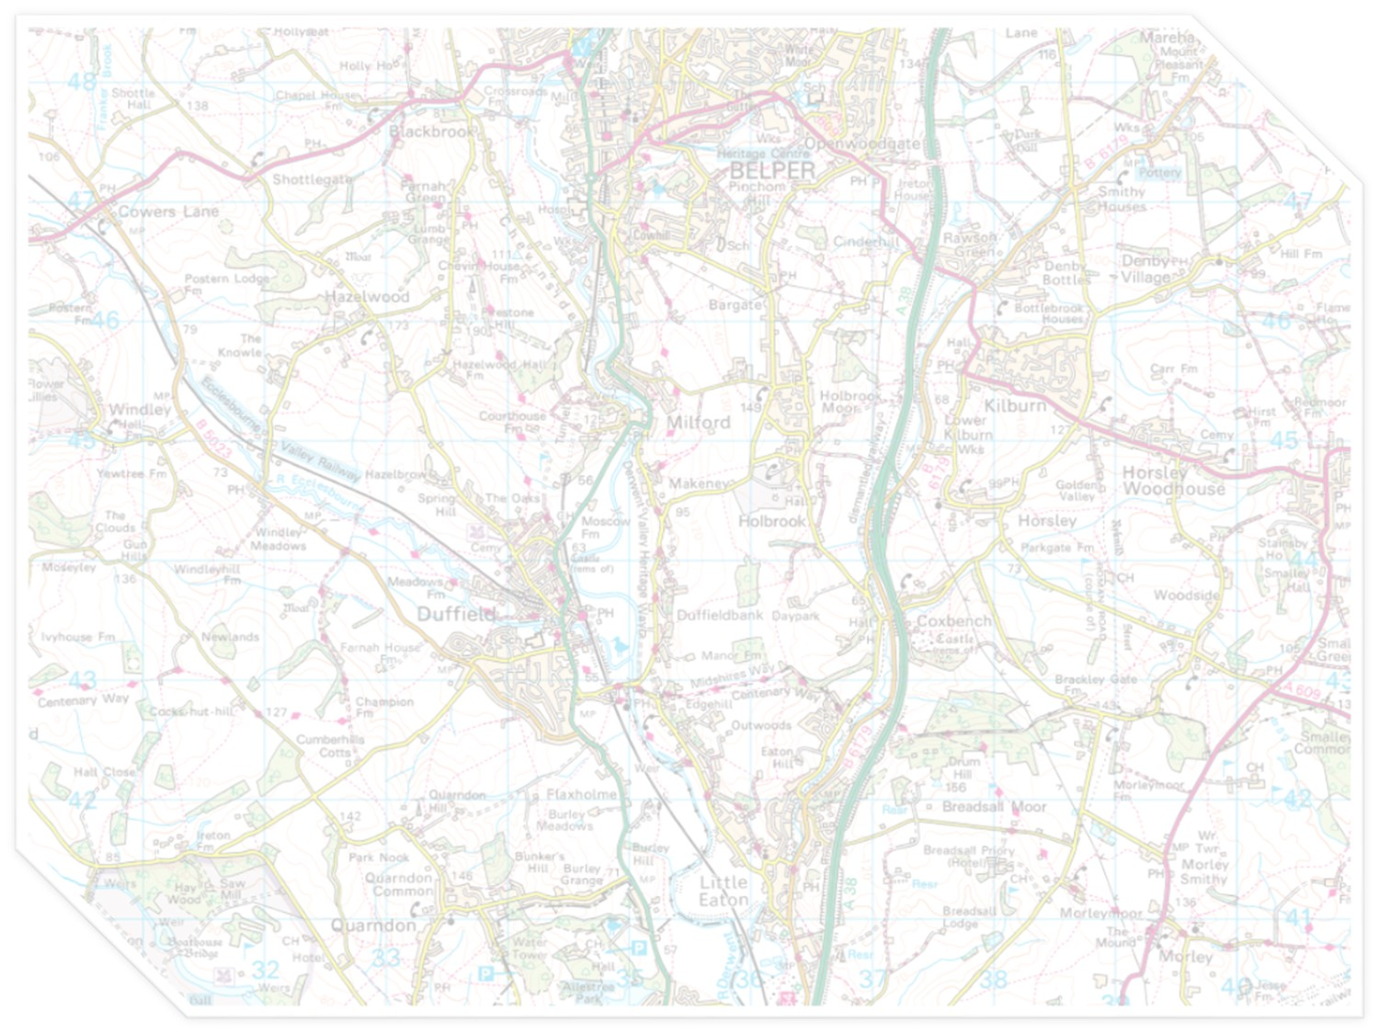


Maps and map interpretation
An introduction for geoscientists
Produced by the University of Derby
in conjunction with UKOGL

Slide 2
Aims
This teaching package provides an introduction
to maps and how to identify landforms using contours and cross-sections
It is designed primarily for A-Level and first year undergraduate geology and geography students who may have little experience of topographic maps, or for those who haven’t worked with
them recently
Notes:
If you are delivering this session to a class and want to incorporate the two practical sessions, print out multiple copies of Slides 50-52 beforehand and provide graph paper for drawing the cross-section

Slide 3
Contents
Part 1 - Introduction to maps
  Title
  Key (sometimes called legend or explanation)
  Scales
  Contours
Part 2 – Map interpretation
  Contour patterns
  Cross-sections

Slide 4
Part 1 - Introduction to maps
Maps are a 2-D representation of a 3-D world. They are a ‘bird’s eye’ view – as if the viewer is ‘flying’ above the land surface and looking down on it
They show how objects are distributed and their relative size
Maps are a very useful way of visualizing all sorts of data and they are a key tool for geoscientists

Slide 5
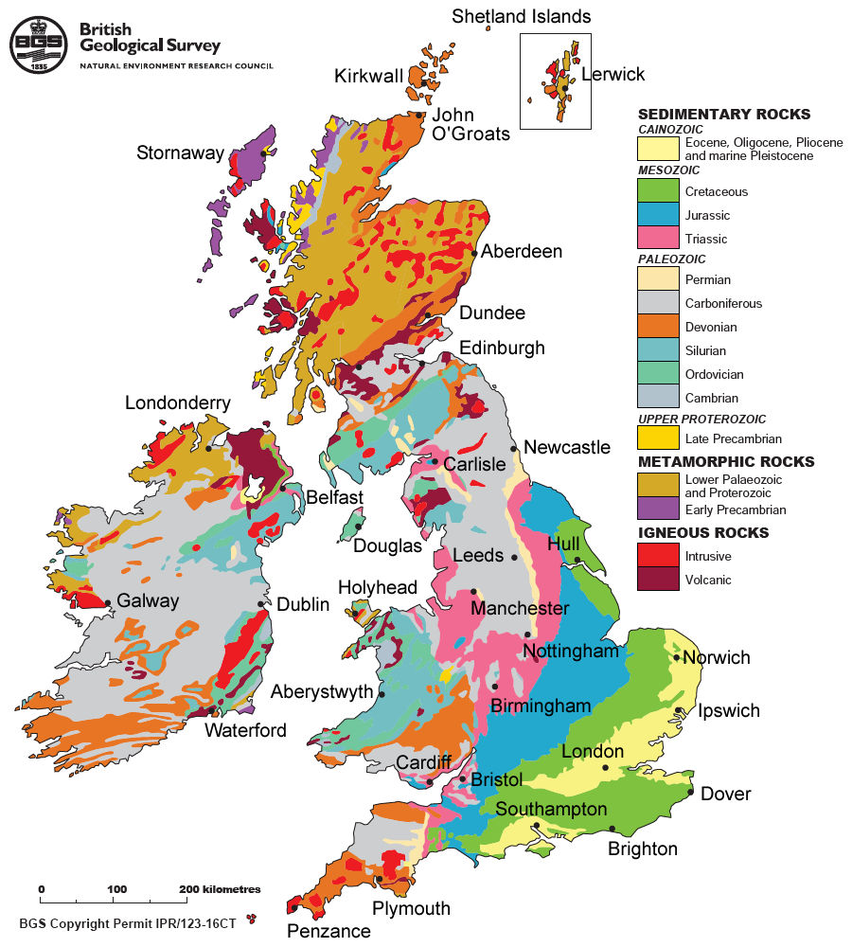
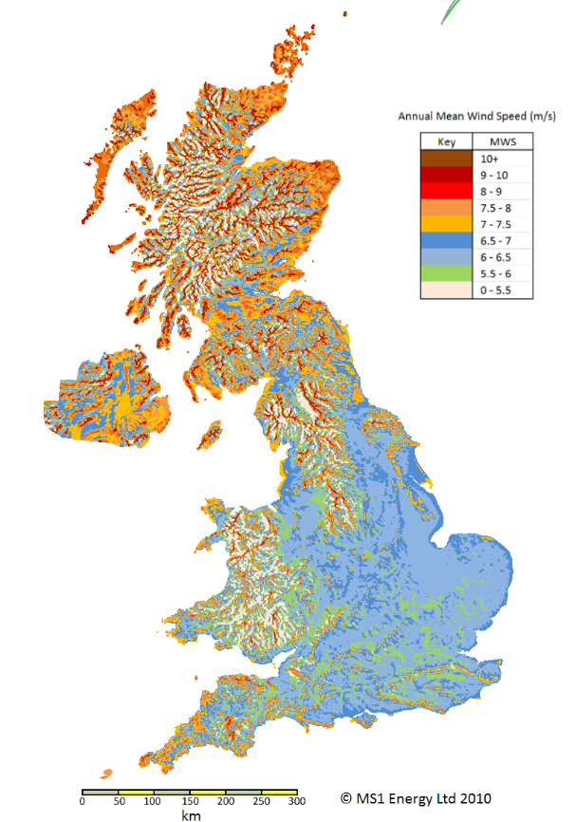
The same map outline can be used to show different information, so it is important to identify the map title, key, scale and orientation
Key
N
N
North Point
Scale
Title
UK Bedrock Geology
UK Annual Mean Wind Speed
Notes:
Questions for students:
Are the maps the same scale and orientation? Answer: Yes
What does the key for the Bedrock Geology Map tell you? Answer: There are three groups of rocks – sedimentary, metamorphic and igneous.

Slide 6
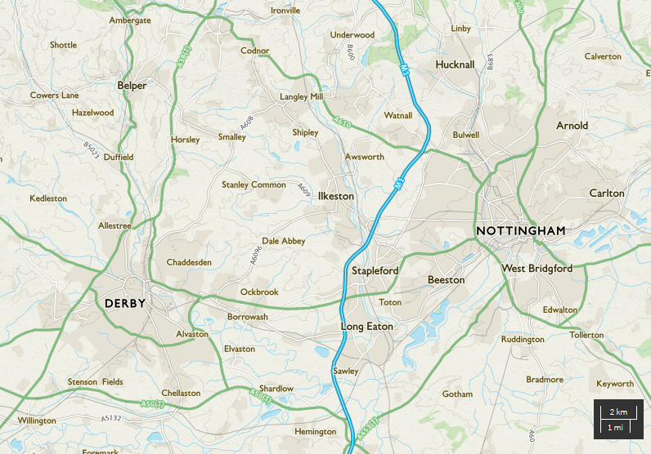
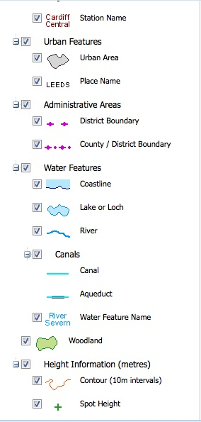
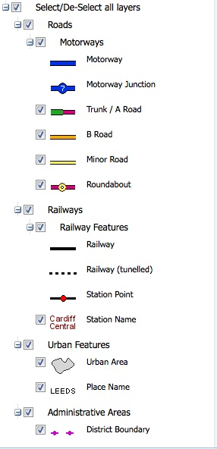
Maps show how objects are distributed and their relative size
This is the area north of Derby
that we will be focusing on later
N
© Crown Copyright/database right 2014. An Ordnance Survey/EDINA supplied service.
Notes:
Which is furthest west, Derby or Nottingham? Answer: Derby
Which occupies the greater area, Derby or Nottingham? Answer: Nottingham

Slide 7
Scales
Show the distance on the map compared to the distance on the ground
It is important to choose an appropriate map
scale for the task you are undertaking
Common scales include:
  1:30 000 000 (e.g. world map or atlas)
  1:1 000 000 (e.g. country map)
  1:50 000 (e.g. regional map)
  1:10 000 (e.g. local map)
A map scale of 1:50 000 means:
  1mm on the map represents 50 000mm or 50m
  or 0.05km on the ground

Slide 8
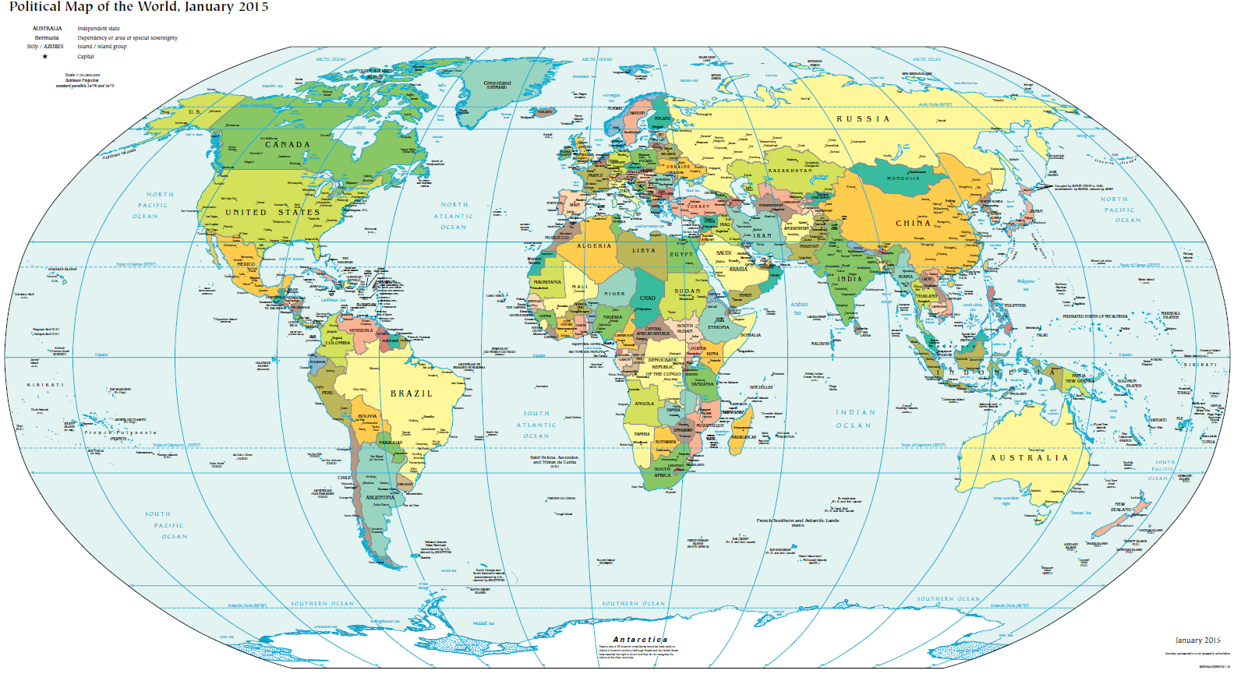
Scales with large numbers (e.g. 30 million) produce
maps covering a large area in little detail
https://www.cia.gov/library/publications/the-world-factbook/docs/refmaps.html

Slide 9
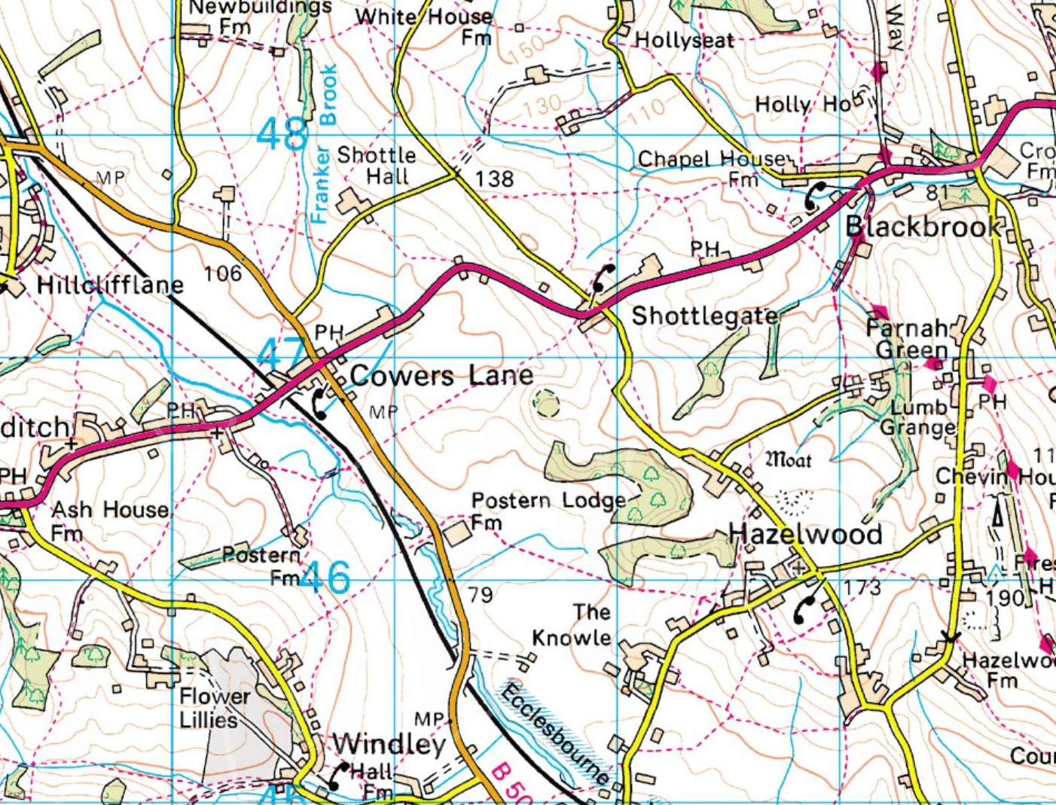
In contrast, on a 1:50 000 map, individual buildings, minor roads and contours are evident
N
© Crown Copyright/database right 2014. An Ordnance Survey/EDINA supplied service.
1 km

Slide 10
The scale bar shows a measurement on the map and
the specific distance it represents on the ground
Cowers Lane to Shottlegate
is about 1 km
N
Galway to Dublin is about 200 km
N
© Crown Copyright/database right 2014. An Ordnance Survey/EDINA supplied service.
1 km
200 km
Notes:
Stress that scale bars are useful when maps are being enlarged or reduced, because they maintain their proportion and can still be used (show reduced inset map as an example)

Slide 11
Contours
Contours are lines joining points of equal value.
This value on topographic maps is height (or elevation/altitude) above mean sea level (MSL)
Each successive contour represents an increase or decrease in constant value. Often every 5th contour will be in bold to help identification
Contours are normally associated with changes in height, but they can represent any parameter
(e.g. thickness, pressure, rainfall). They can also
be called iso-lines (e.g. isopachs, isobars, isohyets)
Notes:
For Ordnance Survey maps the reference point for MSL is taken from Newlyn Harbour, Cornwall.

Slide 12
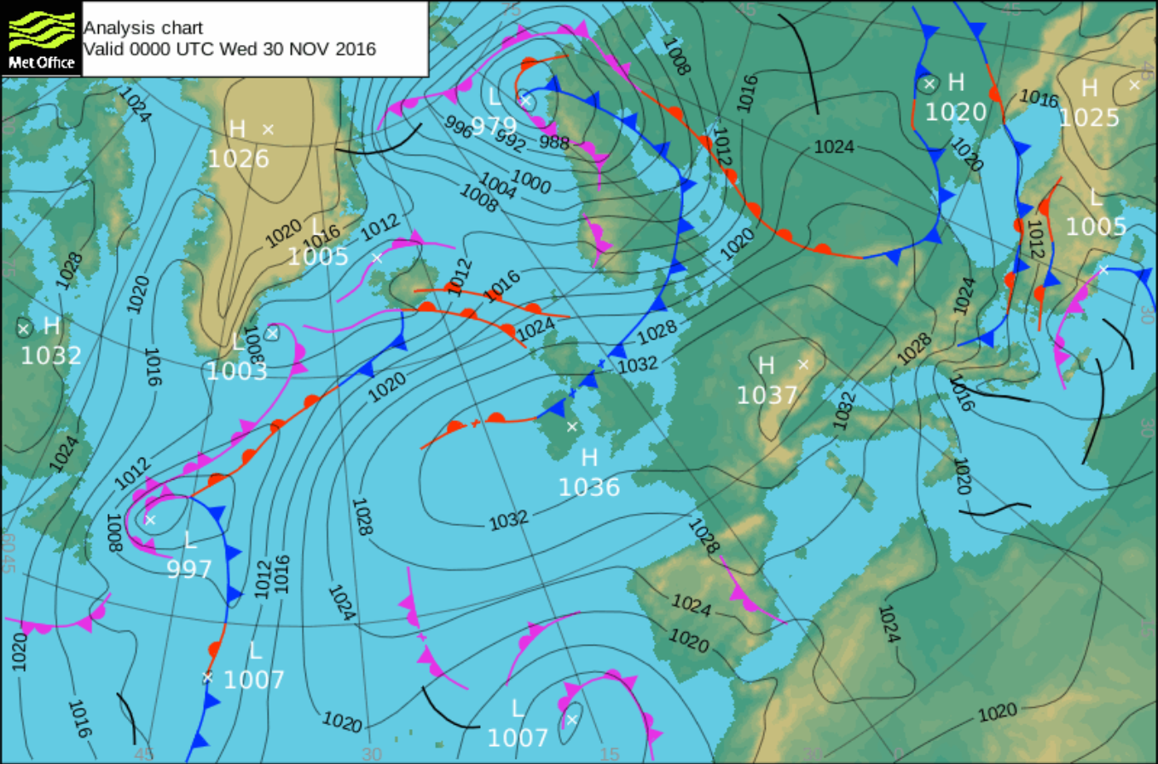
Contours show the distribution and relative
size of any measured value
Surface air pressure is measured in millibars
and is shown here as isobars
Notes:
What is the contour interval? Answer: 4 millibars
Where is the area of highest pressure? Answer: 1037 millibars over Austria
Where is the area of lowest pressure? Answer: 979 millibars over the Norwegian Sea

Slide 13
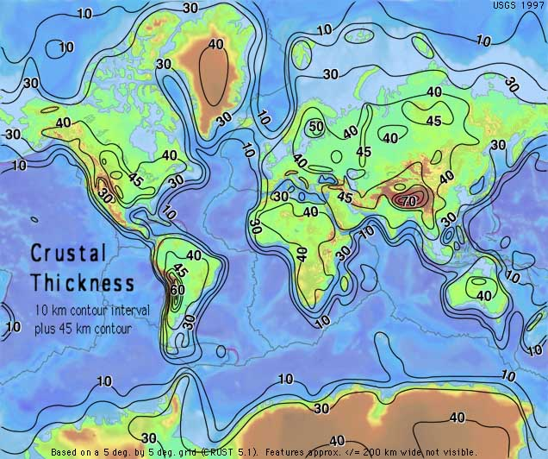
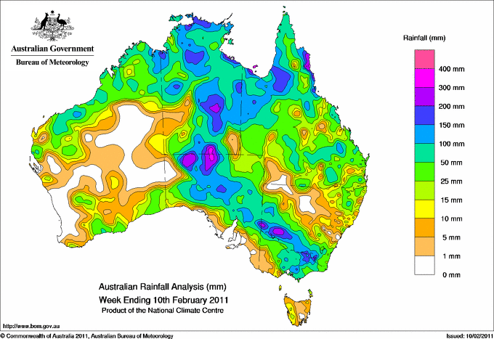
Contours can show the distribution and
relative size of any measured value
This map shows the thickness
of the Earth’s crust (in kms)
This map shows rainfall data for Australia (in mm)

Slide 14
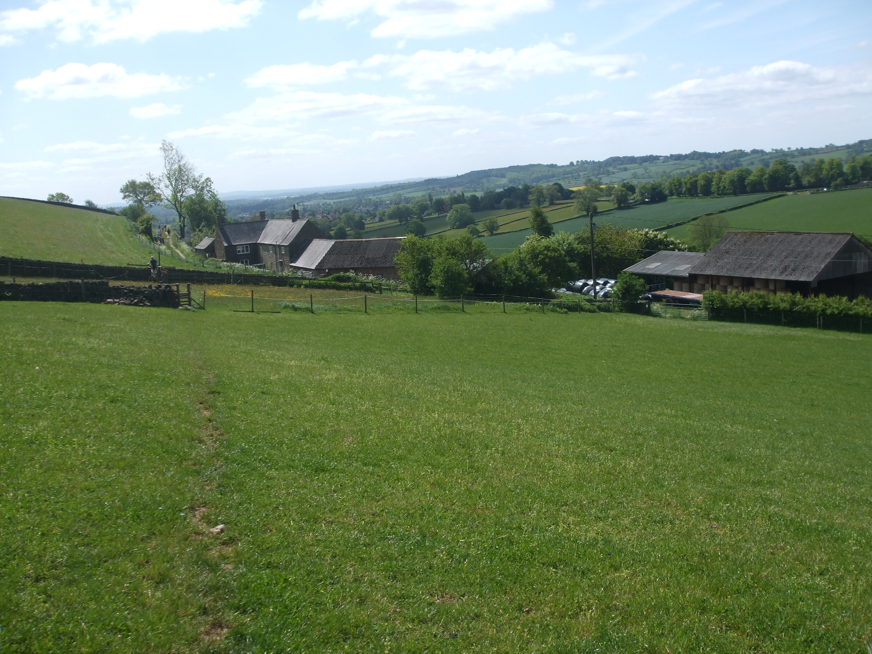
Let’s return to topographic maps - on the map the land surface looks flat, but the contours indicate otherwise
X
View from Point X towards the
SW, showing a valley and
a hill in the distance
N
© Crown Copyright/database right 2014. An Ordnance Survey/EDINA supplied service.
1 km
Notes:
Learning to read contours takes practice. You have to visualize the 3-D shape described by the contour patterns.

Slide 15
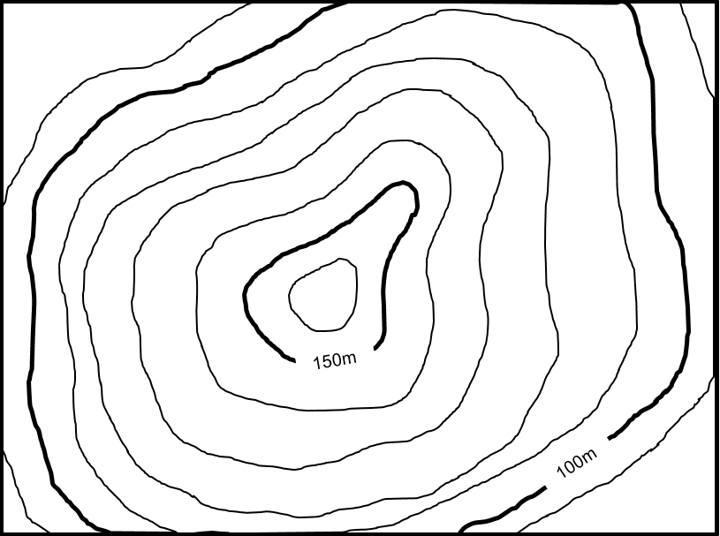
Contours never cross and will at some point close, although this may be off the map. Topographic contours that close
in concentric patterns delineate hills or depressions
1 km
Notes:
Does the diagram show a hill or a depression? Answer: A hill
Note that topographic contour values are written with the bottom of the number on the downhill side

Slide 16
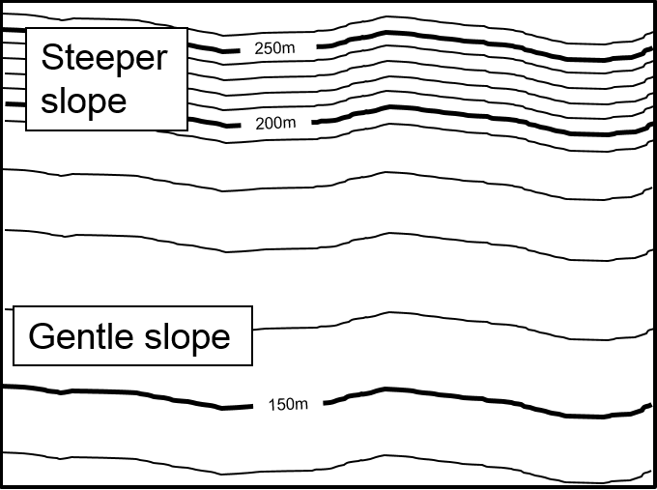
Contours are drawn perpendicular to the maximum slope,
with the spacing between contours indicating
the steepness of the slope
1 km
Notes:
Which direction are the slopes facing? Answer: South
How steep is the steep slope? Answer: Not very – it only rises/falls 50m over a kilometre (about 3˚)

Slide 17
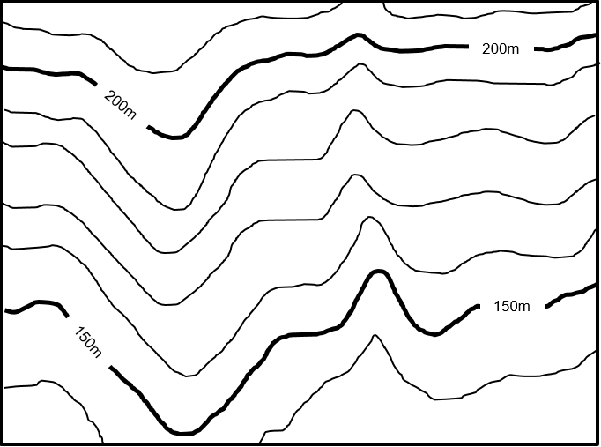
Based on the shape of contours, landforms such
as valleys and ridges can be recognised
Valley and stream
Ridge
1 km
Notes:
Can you recognise a valley and a ridge?
Which direction is the stream flowing towards? Answer: South

Slide 18
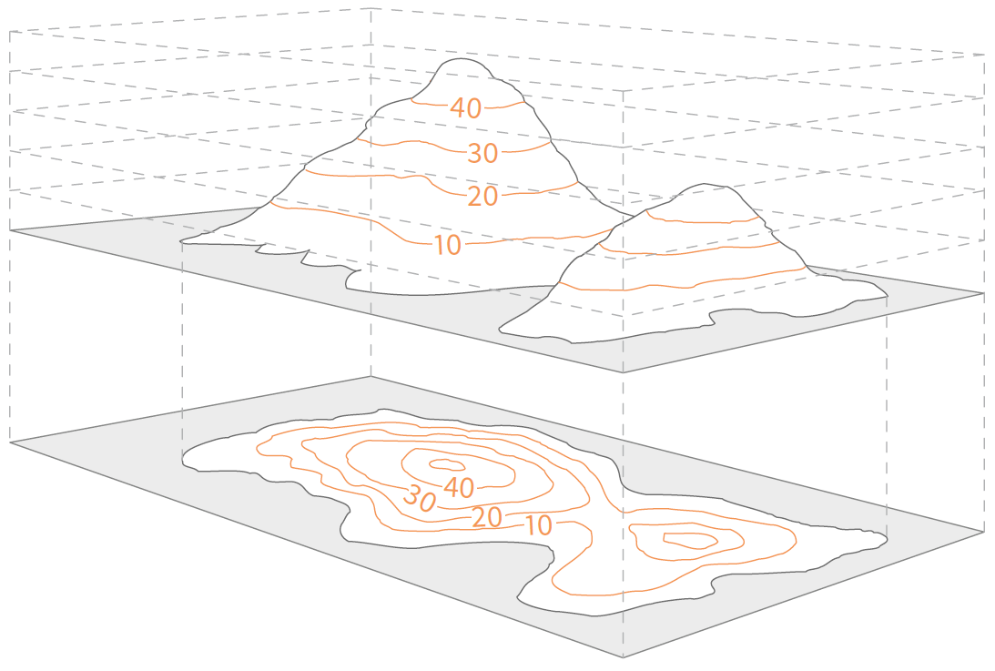
This image highlights the real shape of two hills
and how they are shown on a contour map
40m
30m
20m
10m
0 MSL
Image from OS Map reading made easy. https://www.ordnancesurvey.co.uk/resources/map-reading/index.html

Slide 19
You can watch a video explaining how to read
contour lines on an Ordnance Survey map
Click here to play…
The Ordnance Survey website has further information on
all aspects of maps and map reading, including how to
work out grid references and take compass bearings
https://www.ordnancesurvey.co.uk/resources/map-reading/index.html

Slide 20
Practical exercise 1
Drawing contours

Slide 21
970m
1100m
975m
900m
920m
900m
875m
835m
835m
880m
800m
800m
950m
900m
700m
1070m
800m
900m
Notes:
Sometimes topographic maps are shown with height values at a given point, rather than contours. These are called ‘spot height’ maps and they are rather difficult to interpret. In order to get a better idea of the shape of the land surface the data can be contoured.

Slide 22

The easiest way to draw a contour map based on spot heights is to simply interpolate between the known values.
As you interpolate between points make sure you label the new values, as it quickly becomes very confusing if you don’t!
Then join identical values with smooth curves to create contours that simulate topography
Start by interpolating between individual points, labelling new values as you go.
700m
800m
800m
750m
750m
750m
800m
Then join up all
the original and interpolated points
of equal value to
form contours.
850m
700m
750m
800m
900m

Slide 23
970m
1100m
975m
900m
920m
900m
875m
835m
835m
880m
800m
800m
950m
900m
750
800
700m
1070m
700
800m
900m

Slide 24
Completing the contouring exercise
Based on the contour map you have created:
    Where is the highest ground?
    Where is the lowest area?
    Describe the major landforms
    Mark on the most likely course of a stream and determine in which direction it is flowing
Notes:
The highest ground is in the north (>1100m).
The lowest area is in the SW, in the valley bottom (<700m).
The major landforms are a sinuous valley that trends SW-NE, then W-E, flanked by a broad ridge that trends NW-SE. The ground rises from the valley bottom to a high point in the north.
The stream is flowing from east to west.

Slide 25
1100
1100m
970m
1000
1050
975m
1000
950
950
900m
920m
900m
875m
900
835m
900
850
835m
850
880m
800m
800m
900
950m
900m
950
750
800
1000
700m
1070m
1050
700
800m
900m
Notes:
The highest ground is in the north (>1100m).
The lowest area is in the SW, in the valley bottom (<700m).
The major landforms are a sinuous valley that trends SW-NE, then W-E, flanked by a broad ridge that trends NW-SE. The ground rises from the valley bottom to a high point in the north.
The stream is flowing from east to west.

Slide 26
Part 2 – Map interpretation
Contour patterns can be used to recognise distinctive landforms such as ridges,
valleys and hills
Contours may appear as black or coloured lines
on maps, and are often supported by colour shading to give an impression of relief
Cross-sections provide a useful way of visualizing the shape of the land surface, but care needs to be taken in their construction, particularly in terms of vertical exaggeration

Slide 27
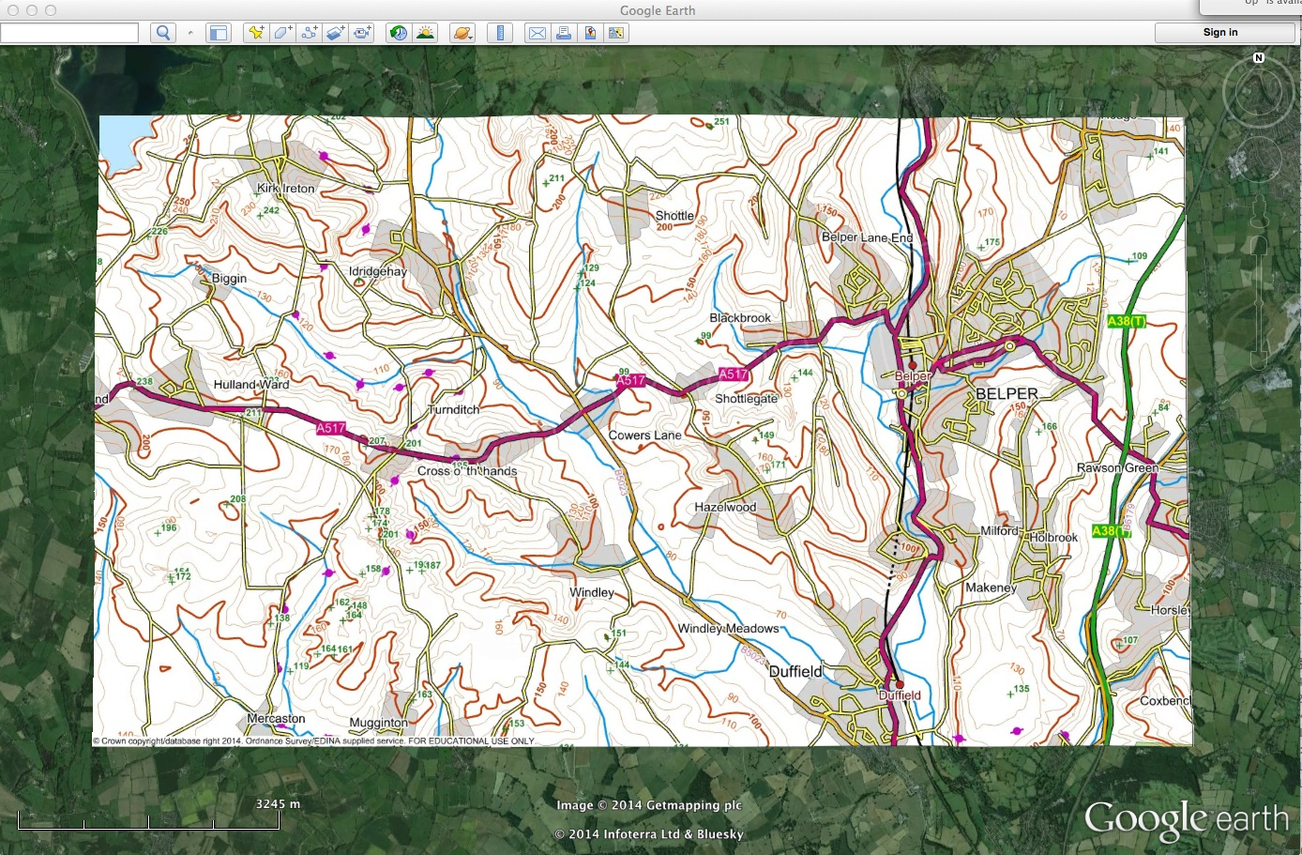
Previously we looked at the topography in this area
– let’s take a closer look at the contours
N
1 km
© Crown Copyright/database right 2014. An Ordnance Survey/EDINA supplied service.

Slide 28
The contour interval is 10m with bold lines every 50m
150m contour
N
© Crown Copyright/database right 2014. An Ordnance Survey/EDINA supplied service.
1 km
What is the contour interval?
Locate the 150m contour between Shottle and Blackbrook

Slide 29
150m contour
N
© Crown Copyright/database right 2014. An Ordnance Survey/EDINA supplied service.
If you walked along this contour, what would your route be like?
Flat, as long as you remain on the 150m contour

Slide 30
200m contour
150m contour
Downhill
100m contour
N
© Crown Copyright/database right 2014. An Ordnance Survey/EDINA supplied service.
Which direction is downhill from the 150m contour?

Slide 31
N
© Crown Copyright/database right 2014. An Ordnance Survey/EDINA supplied service.
What else about the contours help to determine the direction
of slope?
The contour values are perpendicular to the slope,
with the bottom of the number on the downhill side

Slide 32
A
B
N
© Crown Copyright/database right 2014. An Ordnance Survey/EDINA supplied service.
1 km
What does the hillside look like if you stand at Point A
and look towards Point B?
It would go downhill to
the stream and then uphill again to Point B

Slide 33

A useful technique to visualise landforms is to
draw a cross-section. This one is between
Points A and B on the previous map
No vertical exaggeration
A
B
Valley with stream
200
Contour value (metres)
This image shows a similar valley in the area, confirming the gentle slope angles
100
0
100
200
300
400
500
600
700
800
900
Distance (metres)
The X axis represents distance and the Y axis height

Slide 34
When drawing cross-sections it is important to
be aware how the scales affect your
perception of slope angle
2x vertical exaggeration
The purpose will dictate the scales you use. If the cross- section is to highlight relative changes in topography then a vertical exaggeration is fine, despite the fact that it increases the angles of all sloping lines
If there is a need to add sub-surface geology or calculate true slope angles, then there should be no vertical exaggeration
A
B
200
Valley with stream
Contour value (metres)
100
0
100
200
300
400
500
600
700
800
Distance (metres)

Slide 35
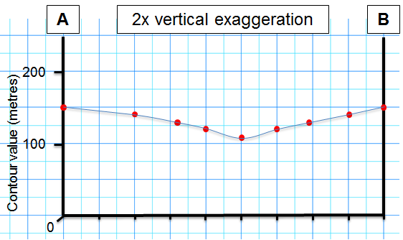
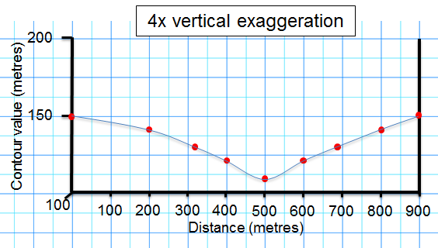
Compare the effects of vertical exaggeration
on the same cross-section
Notice how the change in vertical exaggeration affects the angles of slope
Bear this in mind when drawing your own cross-sections and decide how much (if any) vertical exaggeration is required

Slide 36
Uphill
N
© Crown Copyright/database right 2014. An Ordnance Survey/EDINA supplied service.
You now know how to identify a sloping valley by the shape of
the contours.
They form a V-shape that points uphill

Slide 37
Arrows indicate downhill direction of valleys
N
© Crown Copyright/database right 2014. An Ordnance Survey/EDINA supplied service.
There are lots of valleys on the map; mark them with an arrow
pointing in the downhill direction
Notes:
This map shows some of the main valleys (not all have been marked)

Slide 38
Arrows indicate downhill direction of valleys
N
© Crown Copyright/database right 2014. An Ordnance Survey/EDINA supplied service.
Notice that all the rivers are in valleys, but not all the valleys
have a river. Why is this the case?
Notes:
There is no permanent water in these valleys, however in the past there was sufficient water that flowed along these routes to cause erosion and form the valley. Is there any time in the recent geological past when there was greater water flow in this area?

Slide 39
N
© Crown Copyright/database right 2014. An Ordnance Survey/EDINA supplied service.
What feature do the contours in the red area represent?
A broad, N-S trending ridge
Notes:
Notice that the contours have a similar shape to a valley, but the V-shape points downhill

Slide 40
Axis of ridge
C
D
We can draw a cross-section
to confirm our idea
N
© Crown Copyright/database right 2014. An Ordnance Survey/EDINA supplied service.
It may help if you imagine you are standing at Point C on the 150m
contour, looking towards Point D. Would you be able to see Point D?
Notes:
Answer: No; Point D is at the same height (150m) as Point C, but the axis of the ridge is higher (at 175m).

Slide 41
Cross-section showing the broad, gentle ridge
between Points C and D
2x vertical exaggeration
C
D
Standing at Point C you would be unable to see Point D because the
crest of the ridge is higher than Point D
Here some vertical exaggeration is appropriate because the relief is very subtle
Ridge
200
Contour value (metres)
100
0
100
200
300
400
500
600
Distance (metres)

Slide 42
Practical exercise 2
Constructing cross-sections

Slide 43
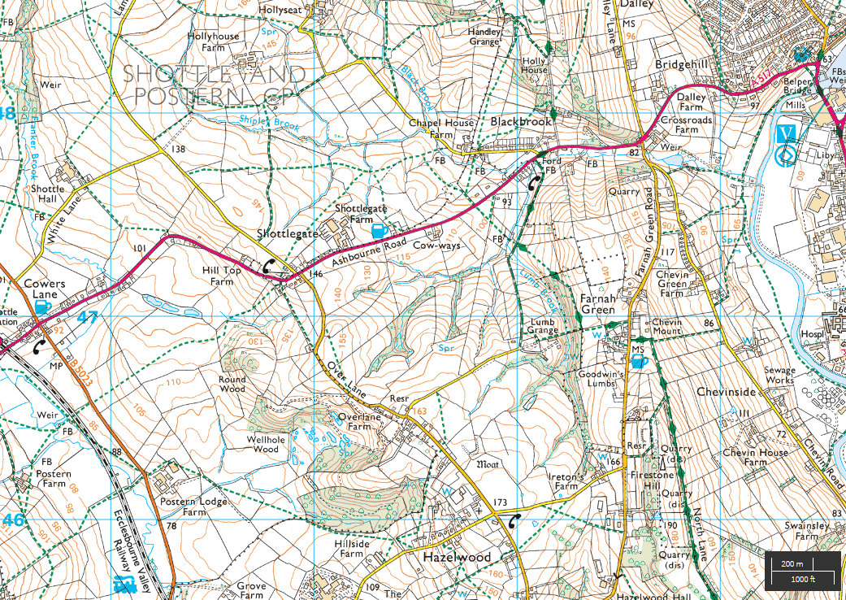
We will now draw our own cross-section between Cowers Lane (A)
and Chevinside (A’)
Before constructing a cross-section, look at the contours and try to imagine what the surface topography looks like
Narrower range of contours between 140-160m indicate a relatively flat hill top
A
A’
Widely spaced contours showing less steep slopes compared to those in the east
Closely spaced contours showing
a steep slope

Slide 44
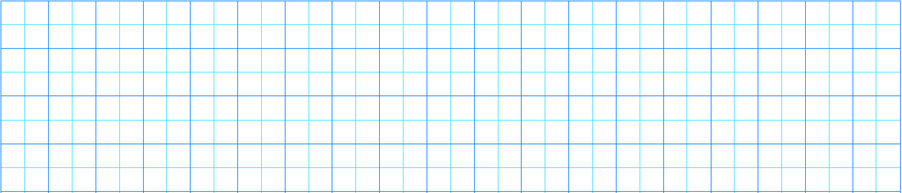
Use graph paper to mark on every time a contour crosses the chosen line of section
Label each contour height and plot the value directly onto the Y-axis of the cross-section
A
A’
200m
85
90
105
100
110
95
150m
100m
50m

Slide 45
Once all the contour heights along the section have been plotted the land surface can be added
This surface should be drawn free hand to give a natural shape that honours the contours
A
A’
200m
150m
100m
50m
4x vertical exaggeration

Slide 46
A completed cross-section between A-A’
The vertical scale has been exaggerated in order to show
the subtle relief. To calculate the vertical exaggeration,
divide the horizontal scale (1cm to 200m) by the
vertical scale (1cm to 50m)
So, 200/50 = 4x vertical exaggeration
A
4x vertical exaggeration
A’
200m
150m
100m
50m
0
West
1 km
2 km
3 km
East
Scale 1: 20 000

Slide 47
Comparison between a vertically exaggerated
section and a true scale cross-section
4x vertical exaggeration
200m
150m
100m
50m
0
No vertical exaggeration
200m
0
The vertically exaggerated section provides a clearer representation of subtle landforms, the other a true representation of slope angles

Slide 48
Learning outcomes
You have now been introduced to the basic elements
of topographic maps
You have used contours to identify common landforms and begun to visualise them in 3-D
You can now construct cross-sections and understand the concept of vertical exaggeration

Slide 49
Handouts required for the practicals
Slide 50: print out at A4, in B/W, portrait format
Slide 51: print out at A4, in colour, portrait format
Slide 52: print out at A4, in colour, portrait format
Graph paper for constructing the cross-section

Slide 50
970m
1100m
975m
900m
920m
900m
875m
835m
835m
880m
800m
800m
950m
900m
700m
1070m
800m
900m

Slide 51
N
© Crown Copyright/database right 2014. An Ordnance Survey/EDINA supplied service.
1 km

Slide 52
A
A’

